Slide 1
Options for prompt optimization

Slide 2
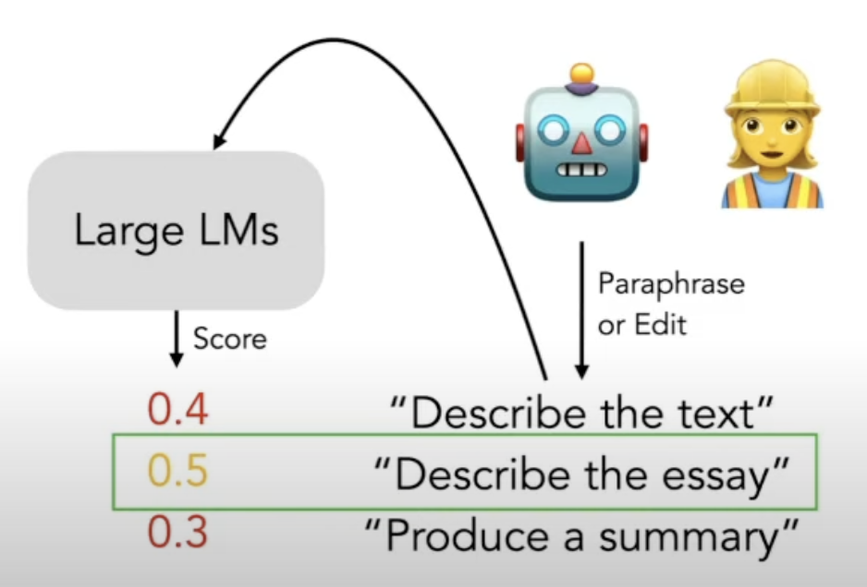
Enumerate and Select

Slide 3
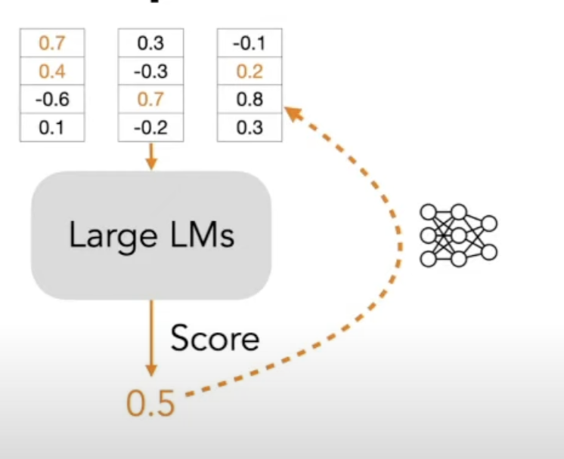
Numerical Tuning
Prompt
Embedding
Iterate the process to get even better score

Slide 4
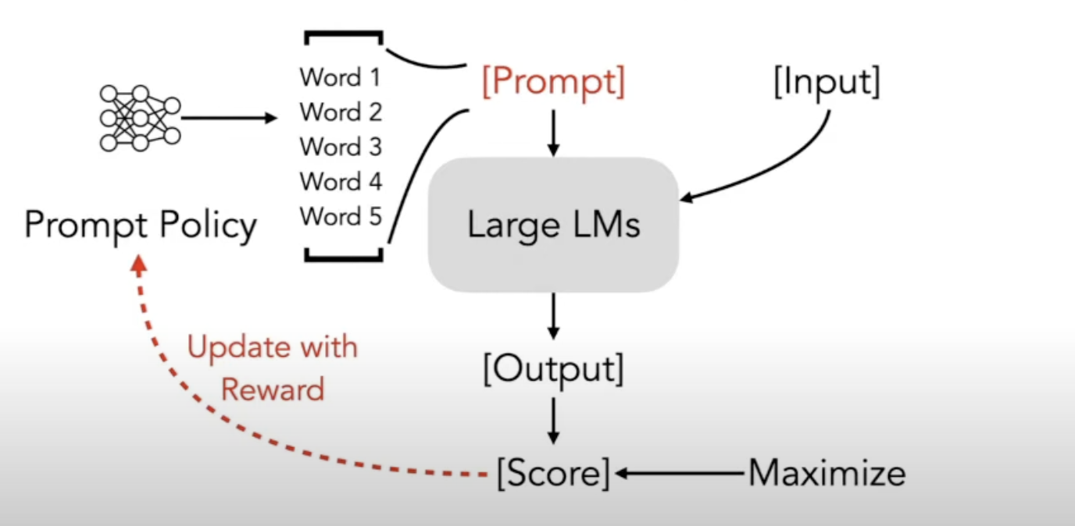
RL Prompt

Slide 5
Evaluation Metrics
BLEU (Bilingual Evaluation Understudy): Primarily focuses on n-gram precision. It measures the overlap of n-grams (contiguous sequences of n tokens) between the generated text and reference texts. BLEU is widely used for machine translation tasks but is also applied to text summarization.
ROUGE (Recall-Oriented Understudy for Gisting Evaluation): Focuses on recall, precision, and F1 score. ROUGE evaluates the overlap of n-grams, word sequences, and sub-sequences (skip-bigrams) between the generated text and reference texts. ROUGE is specifically designed for text summarization tasks.

